Slide 1
Outline
n Importance of Project Communications Management
n Keys to Good Communications
n Three Main Processes
1. Planning Communications Management
2. Managing Communications
3. Monitoring Communications
n Suggests for Improving Project Communications
n Using Software to Assist in Project Communications
2

Slide 2

Importance of Project Communications
Management (1 of 4)
n Failure to communicate is often the greatest threat to the success of any project, especially IT projects
Many problems in other knowledge areas, such as an unclear scope or unrealistic schedules, indicate problems with communication.
Crucial to make good communication a priority, especially with top management and other key stakeholders.
n The IT field is constantly changing, and these changes come with a great deal of technical jargon
When computer professionals communicate with people who aren’t as knowledgeable about computers, technical jargon can often complicate matters and create confusion.
This gap in knowledge and experience causes some of the communication problems between IT professionals and their business colleagues.
3

Slide 3

Importance of Project Communications Management (2 of 4)
n Most IT-related degree programs have many technical requirements, but few of them require courses in communications (incl., speaking, writing, listening), psychology, sociology, and the humanities
IT professionals need those soft skills and cannot separate them from technical skills when working on IT projects
For projects to succeed, every project team member needs both types of
skills, and needs to develop them continuously through formal education and on-the-job training
n Three main processes
1. Plan communications management: determine the information and communications needs of the stakeholders
2. Manage communications: create, distribute, store, retrieve, and dispose of project communications based on communications management plan
3. Monitor communications: ensure that stakeholder communication needs are satisfied
4

Slide 4
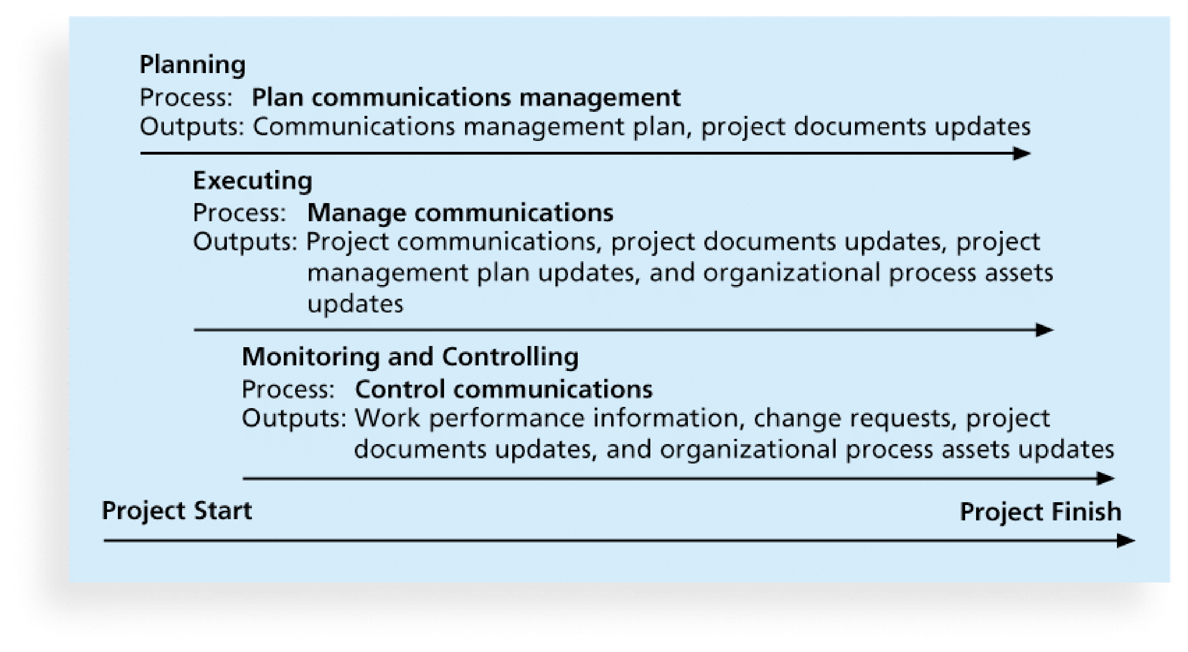
Importance of Project Communications
Management (3 of 4)
5

Slide 5


Importance of Project Communications
Management (4 of 4)
n High demand for IT professionals with good communication and business skills
Organizations are looking for workers with the correct mix of technical, soft, and business skills
Most important non-technical skills
problem solving, teamwork, listening, the ability to adapt to new technologies and languages, time management, the ability to transfer knowledge to
application, multitasking, verbal communication, the ability to visualize and conceptualize, “be the customer” mentality, interpersonal skills,
understanding business culture, inter-team communication, and give and receive constructive criticism
demonstrate solid soft and business skills.”
“The need for these non-technical skills is so great that some IT companies indicate that they will hire individuals with minimum technical skills so long as they
6

Slide 6

Keys to Good Communications
n Project managers can spend as much as 90 percent of their time on communication
Just as it is difficult to understand people and their motivations, it is also
difficult to communicate with people effectively
n Five important concepts
i. Focus on group and individual communication needs
ii. Use formal and informal methods for communicating
iii. Distribute important information in an effective and timely manner
iv. Set the stage for communicating bad news
v. Understand communication channels
7

Slide 7

Focus on Group and Individual Communication Needs (1 of 2)
n People are NOT interchangeable parts
You cannot assume that a task originally scheduled to take two months of one person’s time can be done in one month by two people.
You cannot take nine women and produce a baby in one month!
n Important to understand individual and group preferences for communications
Different people have different personality traits (人格特质), for example, extraversion or introversion, which often affect their communication
preferences.
n Every person is unique, so you cannot simply generalize based on a personality profile or other traits
Seek first to understand, as Stephen Covey suggests in The 7 Habits of
Highly Effective People, and put yourself in someone else’s shoes before you can truly communicate
8

Slide 8
Focus on Group and Individual Communication Needs (2 of 2)
n Project managers should be aware of their own communication styles
Many IT professionals have different personality traits than the general population, which can lead to miscommunication with the latter.
n Moreover, the receiver of information rarely interprets it exactly as the sender intended (agree?)
Important to provide several methods of communications, and an environment that promotes open dialogue.
Be patient and flexible when communicating information and focus on making sure their messages are understood.
n Geographic location and cultural background also affect the complexity of project communications
9

Slide 9



Formal and Informal Methods for
Communicating
n NOT enough for project team members to submit reports to project mangers and other stakeholders
This might work, but many people prefer informal communications
n Project mangers must be good at nurturing relationships through good communications
n Oral communication helps build stronger relationships among project personnel and project stakeholders
People prefer to interact with each other to get a true feeling on a project.
Inf2f interactions, information is communicated through body language, tone of voice, and the spoken tone.
n Communicating includes different dimensions such as writing, speaking, and listening, and project personnel need to use them all effectively
10

Slide 10

Distribute Information in an Effective and
Timely Manner
n Important to include detailed technical information that affects critical performance features of products or services developed in a project
More important to document any changes in technical specifications that
might affect product performance. Such information should not be buried, for example, in an attachment (which will likely be overlooked).
n Oral communications through meetings and informal talks helps bring important information, either positive or negative, into the open
Because IT projects often require a lot of coordination, it is a good idea to have short, frequent meetings.
Some IT project managers require all project personnel to attend a “stand-up” meeting every week or every morning, depending on the project needs.
Recall that projects using the agile approach have daily Scrums to make sure that everyone is one the same page.
11

Slide 11
Set the Stage for Communicating Bad News
n Important to put information in context, especially if it’s bad news
n If there is a problem, know how it will affect the whole project and the organization
Bad news might seem like a major setback, but you can recommend steps to take to mitigate a problem
Project sponsors and other senior managers want to know that you have
evaluated the impact of the situation, considered alternatives, and made a recommendation based on your expertise
n Project managers should know how a major problem might affect the bottom line of the organization and use their leadership skills to handle the challenge
12

Slide 12
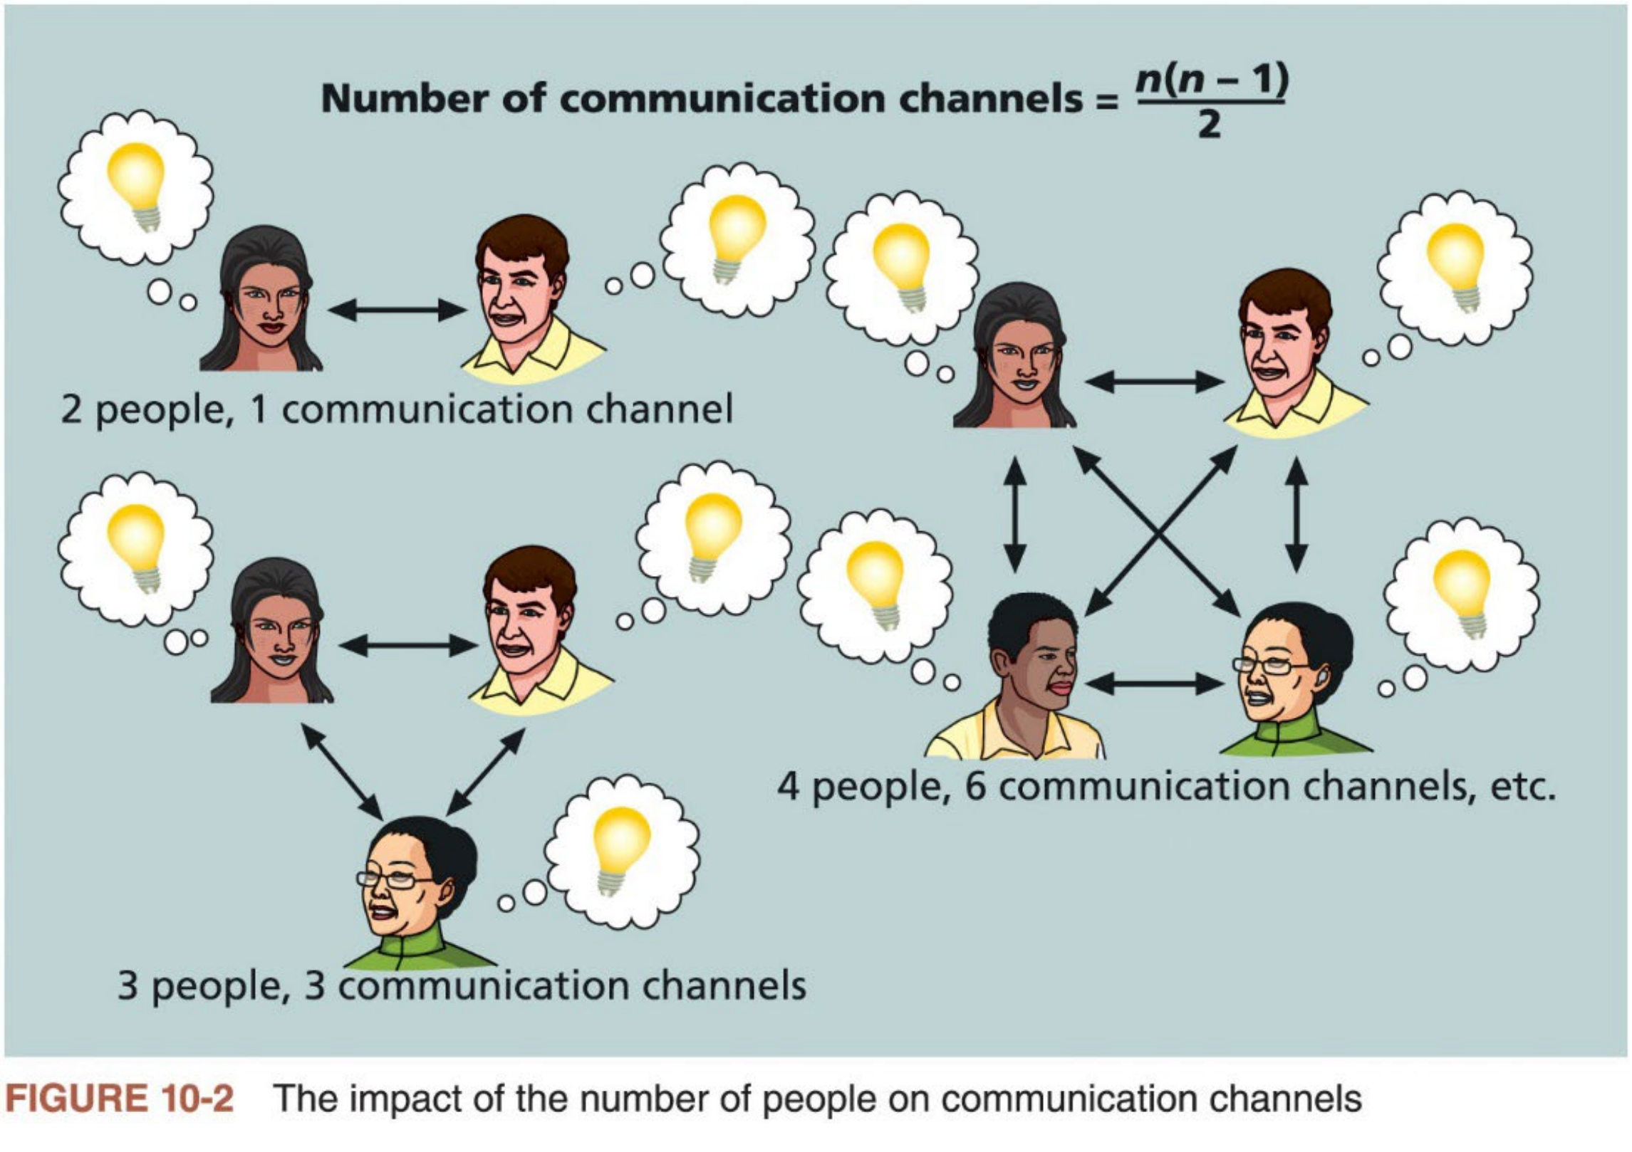
Determine the Number of Communications
Channels (1 of 2)
n As the number of people involved increases, project communications become more complex because of more communication channels
13

Slide 13


Determine the Number of Communications
Channels (2 of 2)
n Good communicators consider many factors before deciding how to distribute information
Such factors include the size of the group, the type of information, and the appropriate communication medium.
The negative effects multiply many times when sending an accidental email message to a group of 500 people, compared with a group of 5 people.
Be very cautious when you must e-mail a large group of people!
n Project communication involves more than creating and sending status reports or holding periodic meetings
Good project managers know their personal strengths and weaknesses in this area and surround themselves with people who complement their skills.
Good practice to share the responsibility for project communications management with the entire project team.
14

Slide 14

Plan Communications Management
(1 of 3)
n Because communication is so important, every project should include a communications management plan (C.M.P.)
a document that guides project communications, as part of the overall project management plan
n C.M.P. varies with the needs of the project, but some type of written plan should always be prepared
For small projects, it can be part of the team charter. For large projects, it should be a separate document.
n Content of C.M.P.
i. Stakeholder communications requirements
ii. Information to be communicated, including format, content, and level of detail
iii. Who will receive the information and who will produce it
15

Slide 15
Plan Communications Management
(2 of 3)
iv. Suggested methods or technologies for conveying the information
v. Frequency of communication
vi. Escalation procedures for resolving issues
vii. Revision procedures for updating the communications management plan
viii. A glossary of common terminology
n Important to know what kinds of information will be distributed to which stakeholders
Stakeholder communications analysis helps avoid wasting time and money on creating or disseminating unnecessary information. Having it reviewed and approved by stakeholders to ensure its correctness.
Table 10-1 provides a sample stakeholder communications analysis
n If an organization works on many projects, developing some consistency in handling project communications helps it run smoothly
16

Slide 16
Plan Communications Management (3 of 3)
Stakeholders | Document Name | Document Format | Contact Person | Due
Customer management | Monthly status report | Hard copy and meeting | Tina Erndt, Tom Silva | First of month
Customer business staff | Monthly status report | Hard copy | Julie Grant, Sergey Cristobal | First of month
Customer technical staff | Monthly status report | E-mail | Li Chau, Nancy Michaels | First of month
Internal management | Monthly status report | Hard copy and meeting | Bob Thomson | First of month
Internal business and technical staff | Monthly status report | Intranet | Angie Liu | First of month
Training subcontractor | Training plan | Hard copy | Jonathan Kraus | November 1
Software subcontractor | Software Implementation plan | E-mail | Najwa Gates | June 1
Comments: Put the titles and dates of documents in e-mail headings and have recipients acknowledge receipt.
Table 10-1 Sample stakeholder communications analysis
17

Slide 17
Manage Communications
n Managing communications is a large part ofa project manager’s job
Getting project information to the right people at the right time in a useful format is as important as developing the information in the first place
n Project managers must decide who receives particular information and determine the best way to create and distribute the information
Stakeholder communications analysis serves as a good starting point for managing communications
n Three important considerations
i. Using technology to enhance information creation and distribution
ii. Selecting appropriate communication methods and media
iii. Performance reporting
18

Slide 18

Use Technology to Enhance Creation and Distribution
n Technology can facilitate the process of creating and distributing information, when used effectively
Most people and businesses rely on e-mail, instant messaging, websites, telephones, cell phones, texting, and other technologies to communicate.
Use PM information system to create and organize project documents, schedules, meeting minutes, and customer requests, and make them
available in an electronic format.
Storing templates and samples of project documents electronically makes information distribution easier.
Important to have backup procedures in place in case something goes wrong with normal communications technologies.
n Communication method and media are two important considerations in technology selection
19

Slide 19
Select Appropriate Communication Methods and Media (1 of 2)
n Three communication methods
1. Interactive communication: two or more people interact to exchange
information via meetings, phone calls, or video conferencing. This method is usually most effective way to ensure common understanding.
2. Push communication: information is sent or pushed to recipients without
their request via reports, e-mails, faxes, voice mails, and other means. This
method ensures that the information is distributed but does not ensure that it was received or understood.
3. Pull communication: information is sent to recipients at their request via
websites, bulletin boards, e-learning, knowledge repositories like blogs, and other means.
n Also, important to consider the communication media
For example, after you have decided to use interactive communication to review an important topic with the project sponsor, you still need to
determine which medium to use.
20

Slide 20
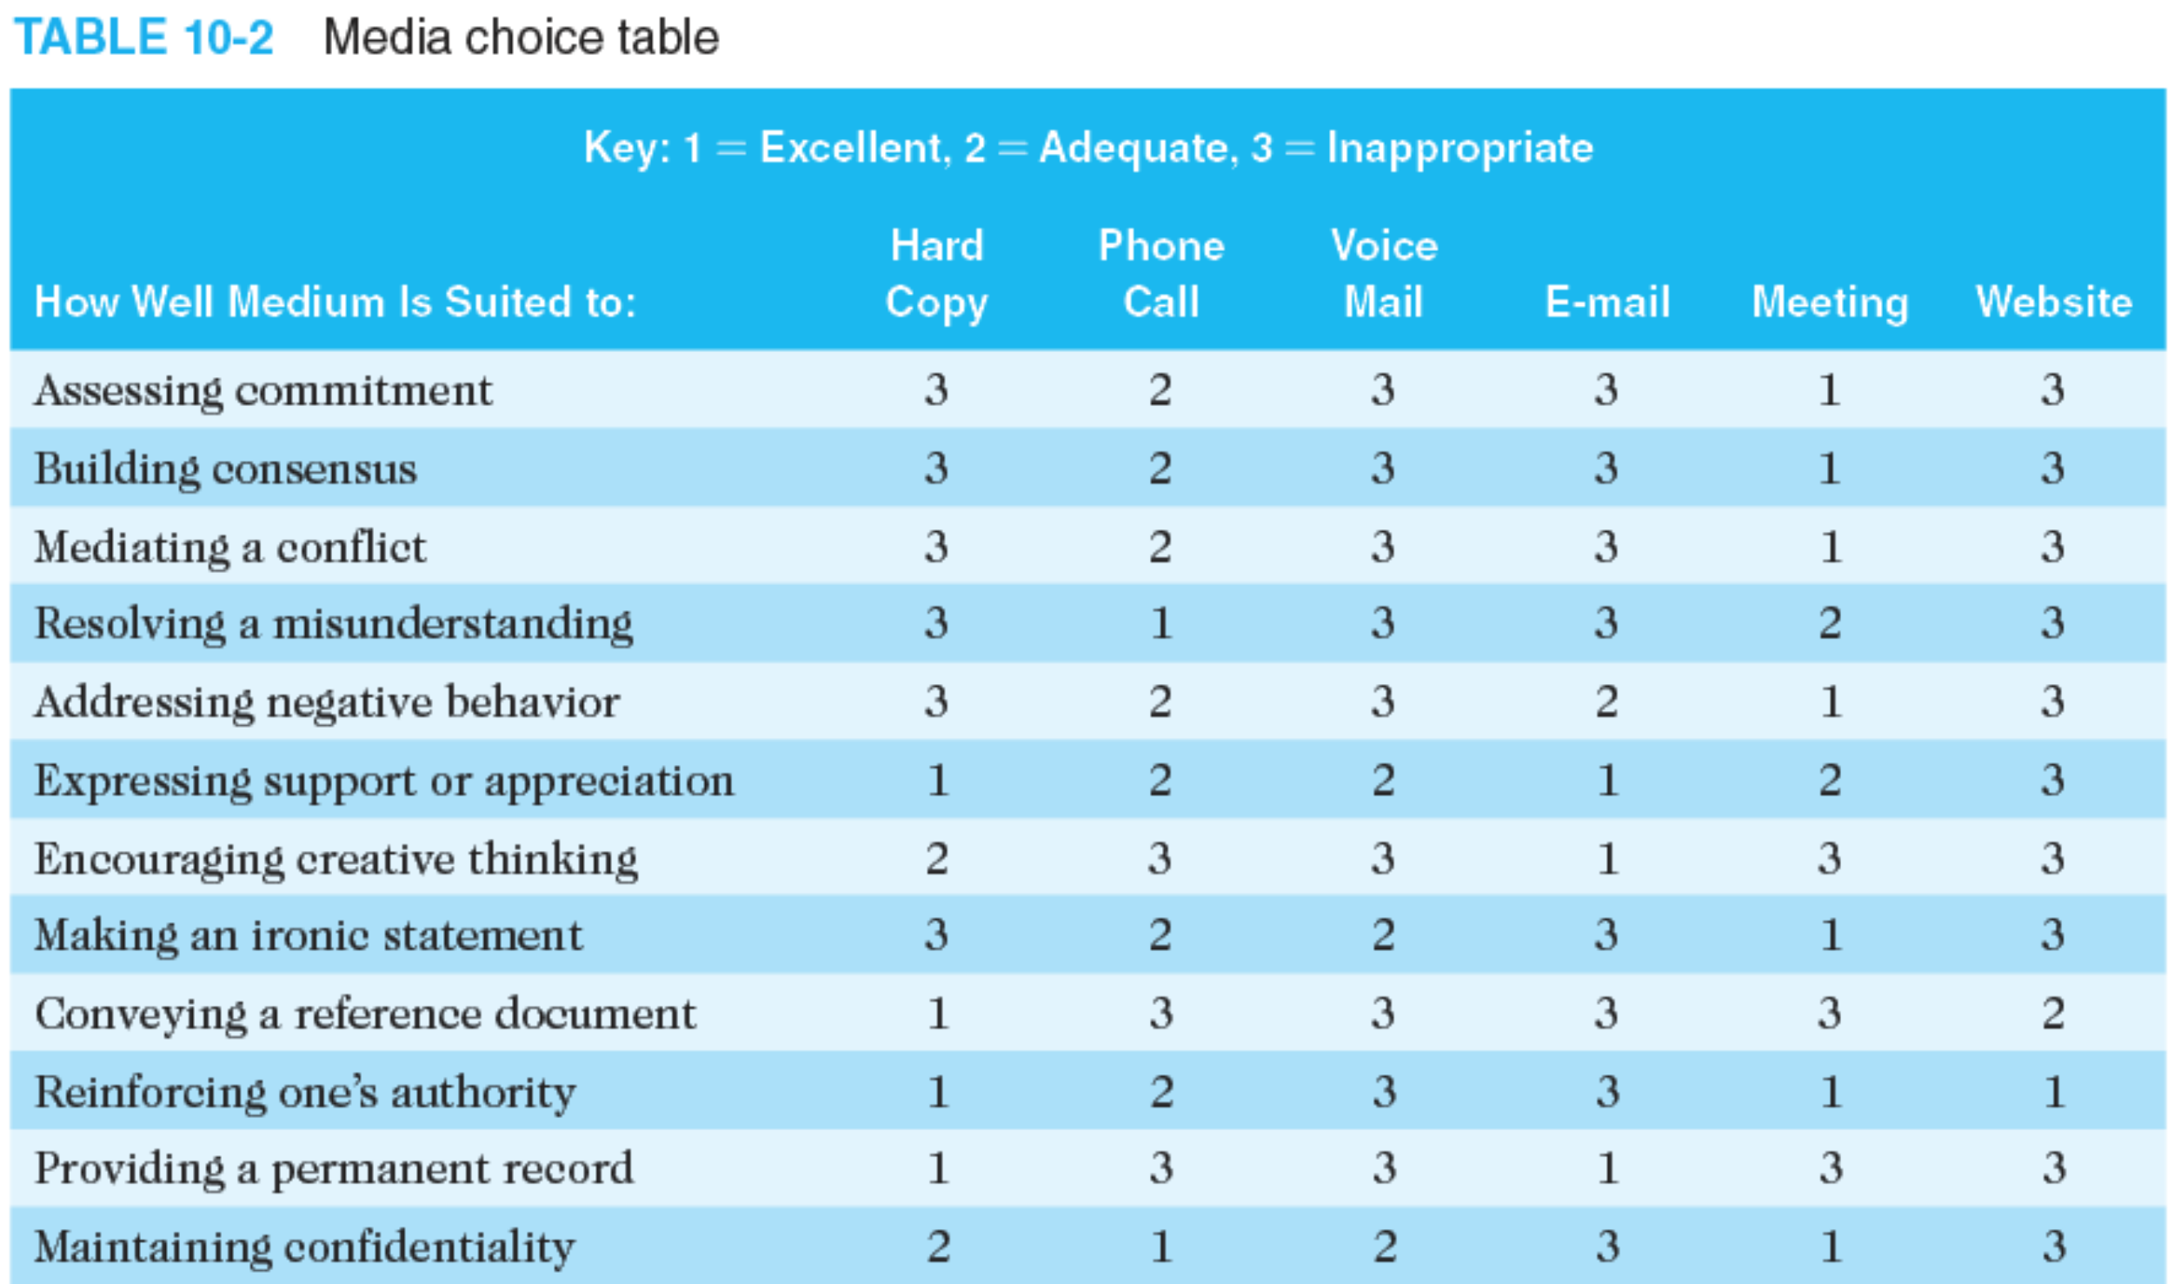
Select Appropriate Communication Methods
and Media (2 of 2)
n Project managers must assess the needs of the organization, the project, and individuals in determining which medium to use and when
Table 10-2 of the textbook provides guidelines about how well different types of media are suited to different communication needs.
21

Slide 21

Report Performance (1 of 2)
n Performance reporting keeps stakeholders informed about how resources are used to achieve project objectives
It also motivates workers to have some progress to report
n Two types of performance reports
1. Progress reports describe what the project team has accomplished during a certain time period.
2. Status reports describe where the project stands at a specific point in time in terms of meeting scope, time, and cost goals.
n Forecasts predict future project status and progress based on past information and trends
Key questions: how long will it take and how much money will be needed to complete the project based on how things are going?
Project managers can use earned value management (EVM), introduced in Pro. Cost Mgmt., to answer these questions.
22

Slide 22

Report Performance (2 of 2)
n Status review meetings are periodic meetings held at different levels (e.g., project level, program level, organization level) to
i. highlight information provided in important project documents
ii. empower people to be accountable for their work, and
iii. have face-to-face discussions about important project issues
n Status review meetings sometimes become battlegrounds where conflicts between different parties come to a head
Project or senior managers should set ground rules to control the amount of conflict and should work to resolve any potential problems.
n Important that project stakeholders work together to address performance problems
23

Slide 23

Monitor Communications
n ensure the optimal flow of information throughout the entire project life cycle
n Expert judgment, PM information systems, data representation,
interpersonal and team skills, and meetings are used to assess how well communications are working
If problems exist, action needs to be taken, often requiring changes to the earlier processes of planning and managing project communications
n Main outputs
Work performance information, change requests, PM plan updates, and project documents updates
n Often beneficial to have a facilitator from outside the project team assess how well communications are working and help solve communication
problems
24

Slide 24
Suggestions for Improving Project Communications
n Guidelines for improving project communications
i. Develop better communication skills
ii. Run effective meetings
iii. Use e-mail, instant messaging, texting, Kanban boards, and collaborative tools effectively
iv. Use templates for project communications
25

Slide 25

Develop Better Communication Skills
n Both technical and communication skills can be developed
Most IT professionals enter the field because of their technical skills.
Communication skills, however, are the key to advancing in their careers, especially if they want to become good project managers.
A minimum investment in communication and presentation training can have a large payback to individuals, their projects, and organizations.
n Communication can be improved with proper planning, support, and leadership from top management
Top management must set high expectation and lead by example
Some organizations send all IT professionals to training that develops both technical and communication skills
n Global organizations also need to invest in improving communications with people from different countries and cultures
26

Slide 26
Run Effective Meetings (1 of 2)
n A well-run meeting can foster team building and reinforce expectations, roles, relationships, and commitment to the project
A poorly run meeting can have a detrimental effect on a project
Many people complain about the time they waste in unnecessary or poorly executed meetings
n Guidelines to help improve time spent at meetings
i. Determine if a meeting can be avoided. DO NOT have a meeting if there is a better way to achieve the objective at hand.
ii. Define the purpose and intended outcome of the meeting. Be specific about what should happen as a result of the meeting.
iii. Determine who should attend the meeting. Many meetings are most
effective with the minimum number of participants possible, especially if decisions must be made.
27

Slide 27
Run Effective Meetings (2 of 2)
n Guidelines to help improve time spent at meetings (cont’d)
iv. Provide an agenda to participants before the meeting. Meetings are most effective when the participants come prepared.
v. Prepare handouts and visual aids and make logistical arrangements
ahead of time. Project managers must take time to prepare for meetings, especially important ones with key stakeholders.
vi. Run the meeting professionally. Introduce people, restate the purpose, state the ground rules, have someone facilitate the meetings, and designate
someone to take minutes, etc.
vii. Set the ground rules for the meeting. State up front how the meeting will be run. Don’t assume all meetings are run in the same way. Do what
works best in each specific case.
viii. Build relationships. If used effectively, meetings are a good way to build relationships.
28

Slide 28

Use E-Mail, Instant Messaging, Texting, Kanban Boards, and Collaborative Tools Effectively (1 of 2)
n Some popular collaborative tools
Microsoft SharePoint allows users to create custom websites to access documents and applications stored on shared devices.
Google Docs allows users to create, share, and edit documents, spreadsheet, and presentations online.
Wiki is a website that enables anyone who accesses it to contribute to or modify its content.
Kanban boards visually show tasks that need to be done, are in progress, or are completed.
n People need to learn when and how to use different tools for project communications and put ideas into words clearly and effectively
Project managers should help stakeholders to use tools effectively and not waste time with poor or unclear communications.
Use new tools only because they improve communications and productivity, NOT because they are the latest fad.
29

Slide 29


Use E-Mail, Instant Messaging, Texting, Kanban Boards, and Collaborative Tools Effectively (2 of 2)
n Guidelines to use e-mail more effectively (refer to textbook for a full list)
Be sure to send information to the right people
Use meaningful subject lines and limit the content of emails to one main subject
Be as clear and concise as possible
Always re-read your e-mail before you send it
Respond to e-mail quickly
n Guidelines to use other communication tools more effectively
Make sure that your team is using a good tool
Be sure to authorize the right people to share your collaborative documents
Make sure that the right person can authorize changes to shared documents and that you back up files
Develop a logical structure for organizing and filing shared documents
30

Slide 30
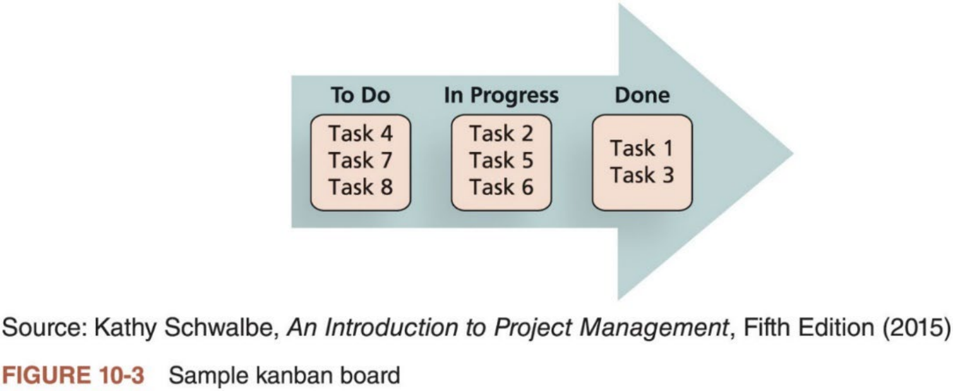
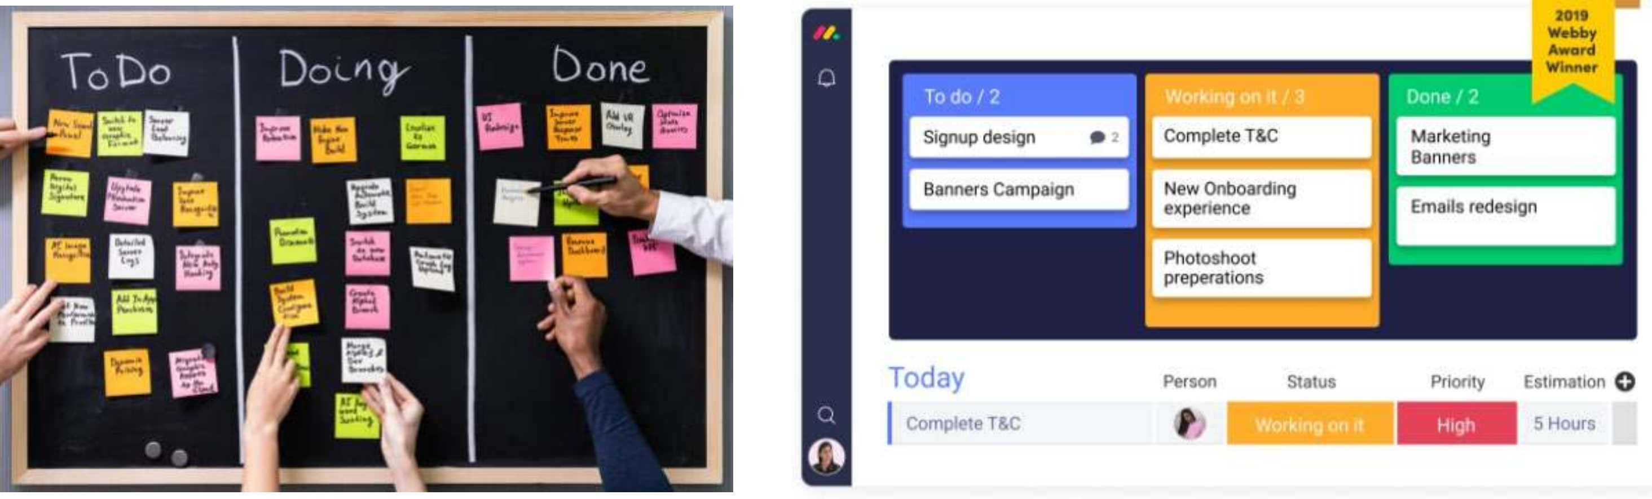
Kanban Boards
n One of the main features of Kanban is visualizing workflow, which is often done by using Kanban boards
n People can tailor the concepts of Kanban boards to meet their needs
31

Slide 31


Use Templates for Project Communications
(1 of 5)
n Many technical people have a hard time writing reports, and they are too embarrassed to ask for help
n Project managers need to provide examples and templates for common project communications such as project descriptions, project charters, performance reports, lessons-learned reports, etc.
Organizations can develop their own templates or use external templates
Finding, developing, and sharing relevant templates and sample documents are important tasks for project managers
n Three sample templates
1. Figure 10-4 shows a sample template for a brief project description
2. Table 10-3 shows a template for a monthly progress report
3. Table 10-4 provides a list of all documentation that should be organized and filed at the end ofa major project
32

Slide 32
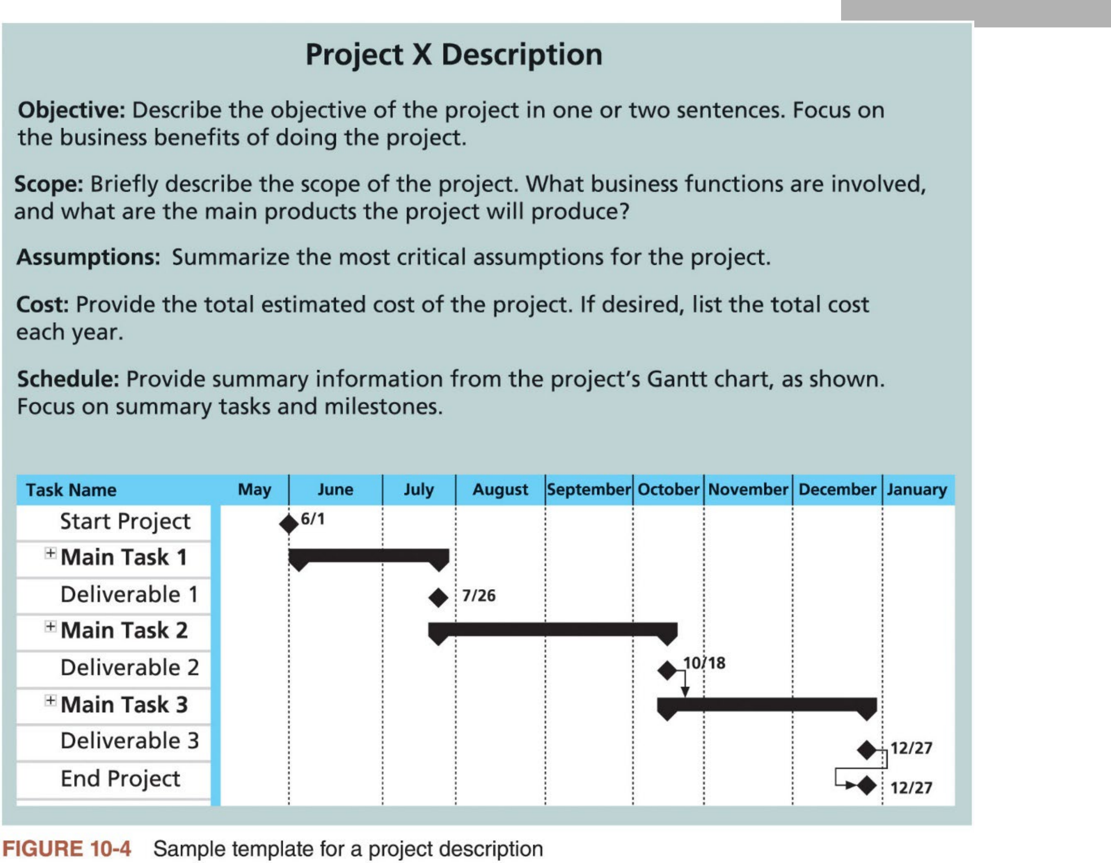
Use Templates for Project Communications
(2 of 5)
33

Slide 33
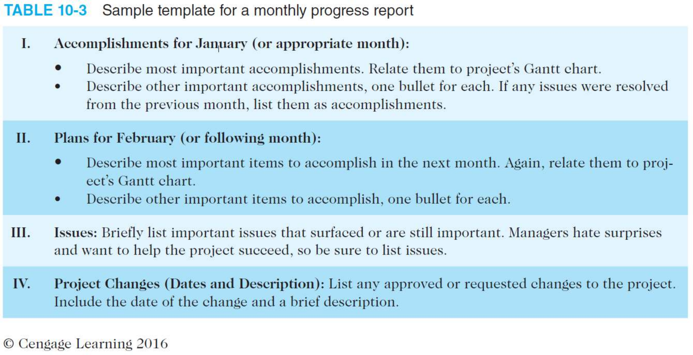
Use Templates for Project Communications
(3 of 5)
34

Slide 34
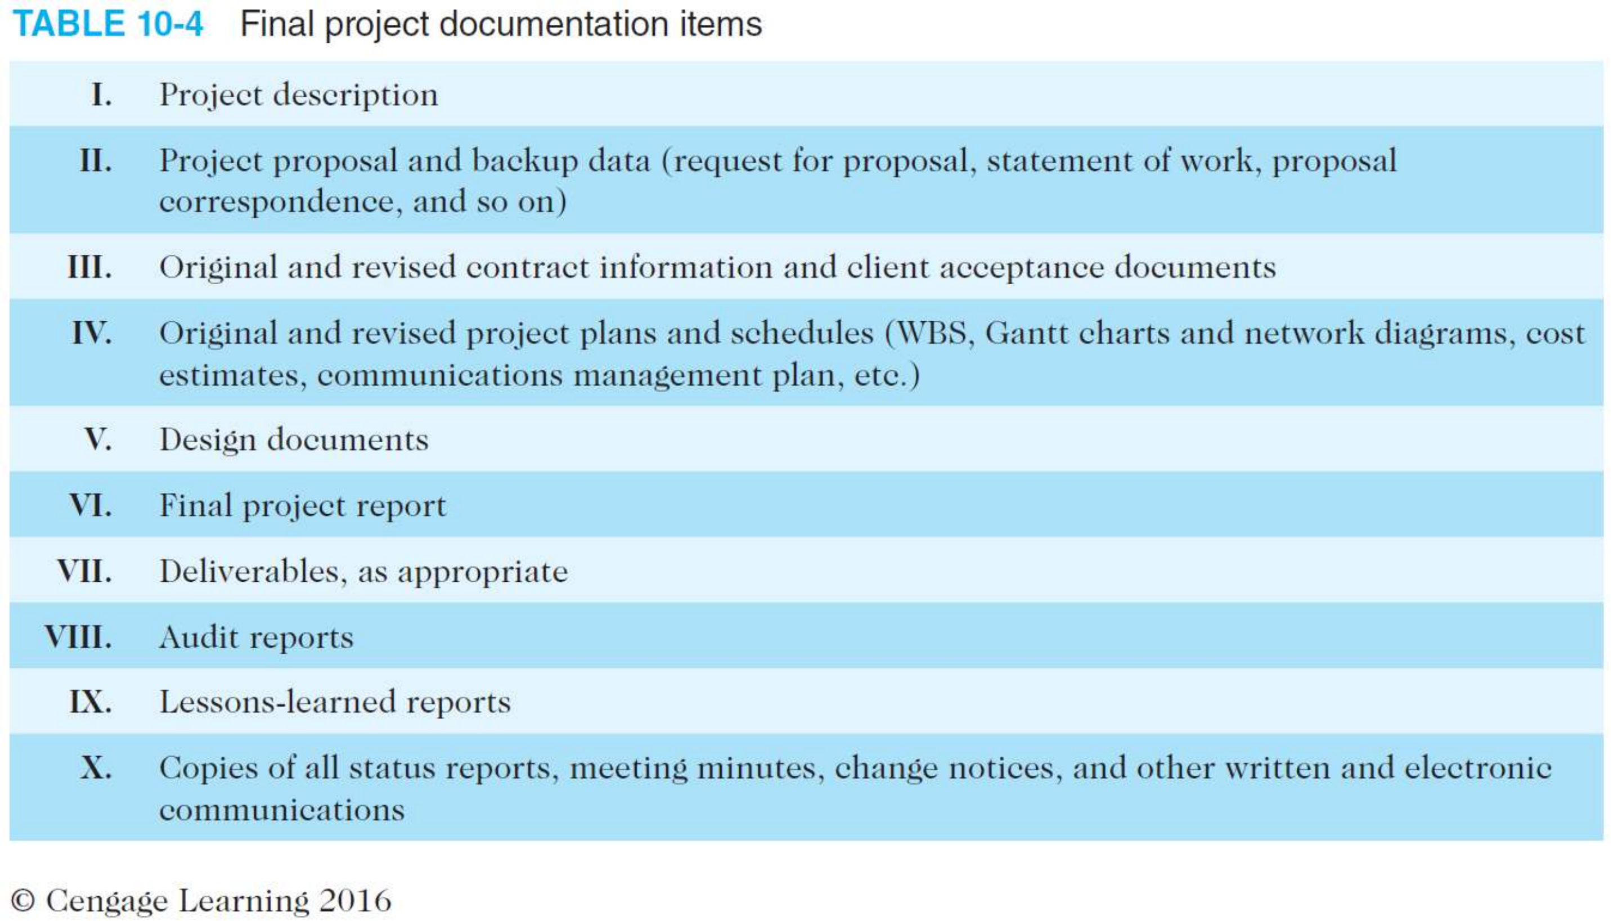
Use Templates for Project Communications
(4 of 5)
35

Slide 35
Use Templates for Project Communications (5 of 5)
n Lessons-learned report is reflective statement that documents important information they have learned from working on the project
These reports can be an excellent resource and can help future projects run more smoothly
n Project archives are a complete set of organized project records that provide an accurate history of the project. They also provide valuable information for future projects.
n More and more project teams have started putting all or part of their project information on project websites
Be sure to address important issues in creating and using a project website, such as security, access, and the type of content to be included.
n Project teams can use one of the many software products available to assist in project communications through the Web
36

Slide 36



Use Software to Assist in Project
Communications (1 of 2)
n Many organizations are discovering how valuable PM software can be in communicating project information across the organization
Provide different views of information to help meet various communication needs from different stakeholders
Allow users to insert hyperlinks to other project-related files
Provide portfolio management, resource management, and project collaboration tools to enhance communications
n Many other products are available to assist individual consumers and organizations with communications
SharePoint, Google Docs, Kanban, Zoom, Tencent meeting, WeChat, etc.
n Even with all technologies available, many organizations have problems communicating on global projects
Differences in time, culture, language, etc.
37

Slide 37
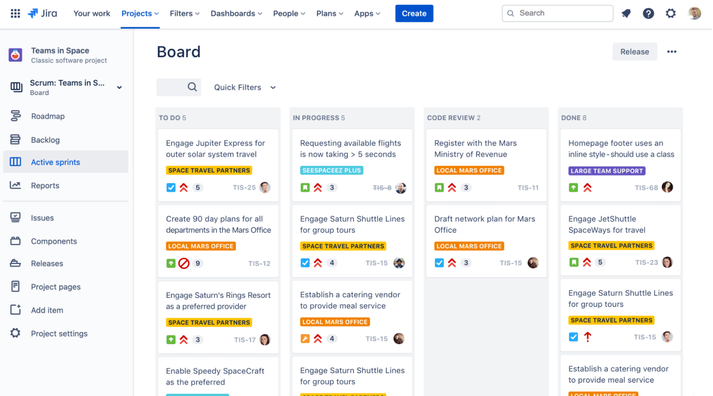
Use Software to Assist in Project Communications (2 of 2)
n Jira by Atlassian is a popular online tool for running agile projects
38

